Slide 1
Intro to Programming
Class 1: Welcome!
November 2021
Emily Gelfand
Emily Joyce

Slide 2
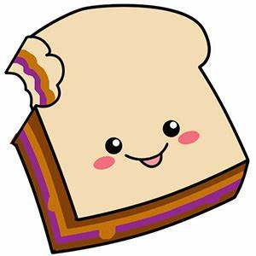
Code = Logic
How would you tell someone to make a PB&J? Exercise time!

Slide 3
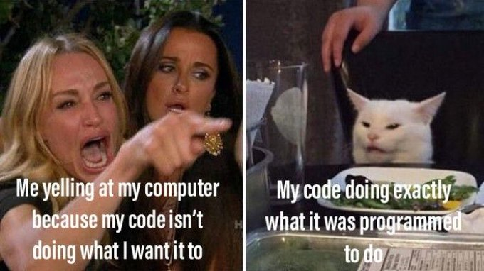
What did you Assume Emily would/wouldn’t know? What did/didn’t EMILY know?

Slide 4
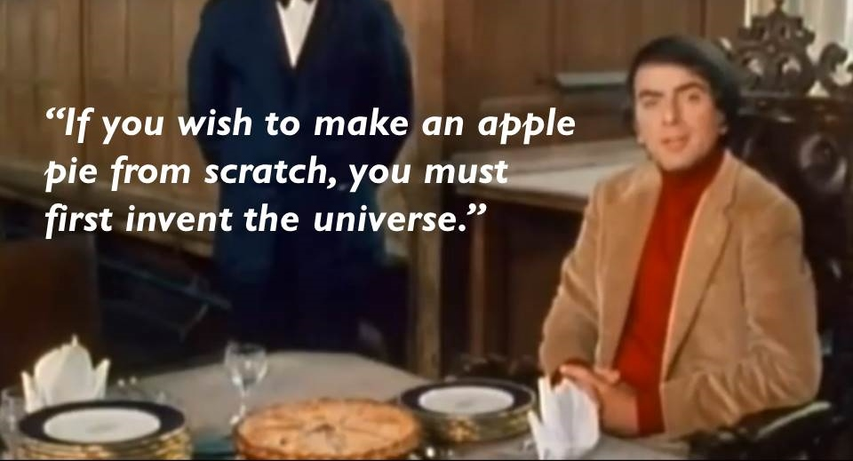
Coding languages are how you explain things from base principles to a computer

Slide 5
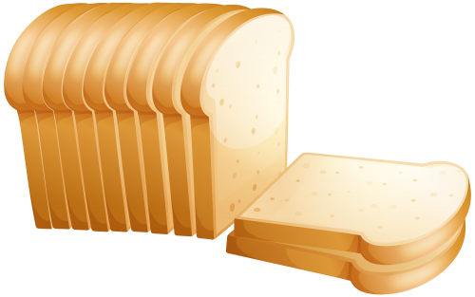
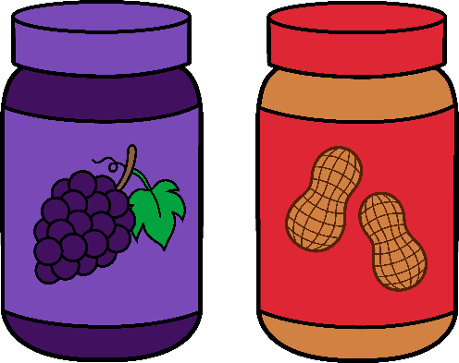


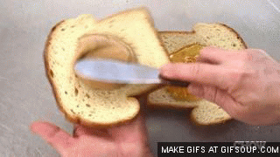
Computers don’t speak English! (yet…)
Don’t worry – a lot of the universe has already been created for you! (Bit logic, assembly, etc, all the way to interpreted languages)
Coding libraries are your friend ☺
Define bread, define knife, define peanut butter and jelly, define spread, etc, then “call” each definition in order

Slide 6
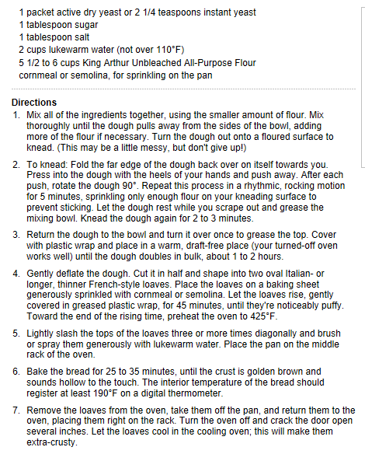
Baking bread – recipe for a person to interpret

Slide 7
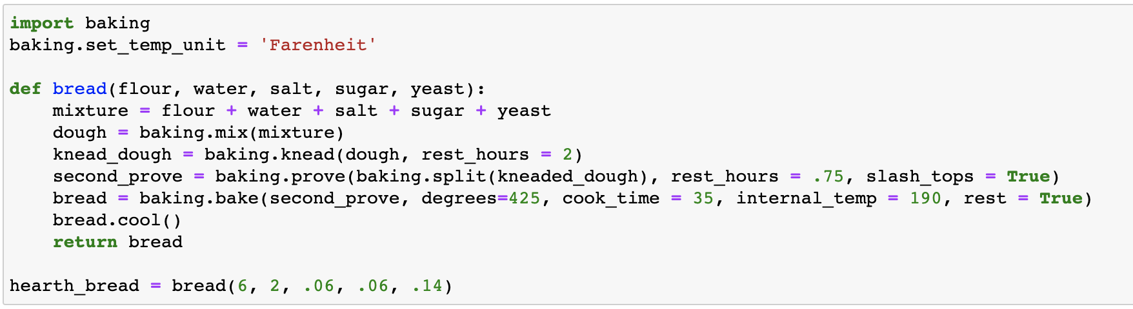
Baking bread – recipe for a computer to interpret
The same instructions written as Python code
Same instructions, same concept, just a different look
Notes:
https://www.kingarthurflour.com/recipes/hearth-bread-recipe

Slide 8
Always pick the right tool for the job
Important to think before choosing a language, and explore what solutions might have pitfalls
For example, Brain Science uses Python extensively (Cell science and Immunology also use R), so using a different language would end up causing compatibility issues (“square peg round hole” issue)
However, if building a website from scratch, HTML/CSS/JavaScript would be more appropriate languages for getting started.
Frequently, when choosing a language, the primary reason for the choice is “your industry/employer/field does this and you have to as well in order to be compatible”.
However, when working on personal projects, or when transitioning to new tools, you’ll have to know what makes sense and what doesn’t, and therefore awareness of language differences is important.

Slide 9
Why Choose Python?
Designed for clear, logical code that is easy to read and easy to learn
Lots of existing code libraries and frameworks are written in Python allowing users to apply Python to a wide variety of tasks
Focuses on optimizing the time it takes to write the code rather than the time it takes the computer to execute the code
Great documentation online and lots of places to find help – docs.python.org/3
Notes:
Ever since the beginning, Python was designed to be easy to read and easy to learn.
Even if you don’t know python but you know another programming language, you can usually read python even without knowing the syntax behind it.
Usually, a developer’s time is much more valuable- as a person- rather than just the computer processing time
Documentation – lots of helpful resources

Slide 10
What can you do with python?
Automate simple tasks
Searching for files and editing them all in the same way
Scraping information from a website
Reading and editing excel files
Work with PDFs
Automate emails and text messages
Fill out forms
Data Science and Machine Learning
Analyze large data files
Create visualizations
Preform machine learning tasks
Create and run predictive algorithms
Create websites
Handle the backend of a website and user data
Create interactive dashboards for users
Notes:
Numpy, pandas
Seaborn, matplotlib
Scikitlearn, tensorflow
Python is the most popular language in that field
Django/flask
Plotly/dash

Slide 11
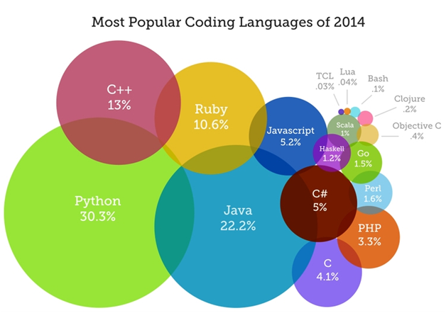
Languages may differ, but also overlap heavily

Slide 12
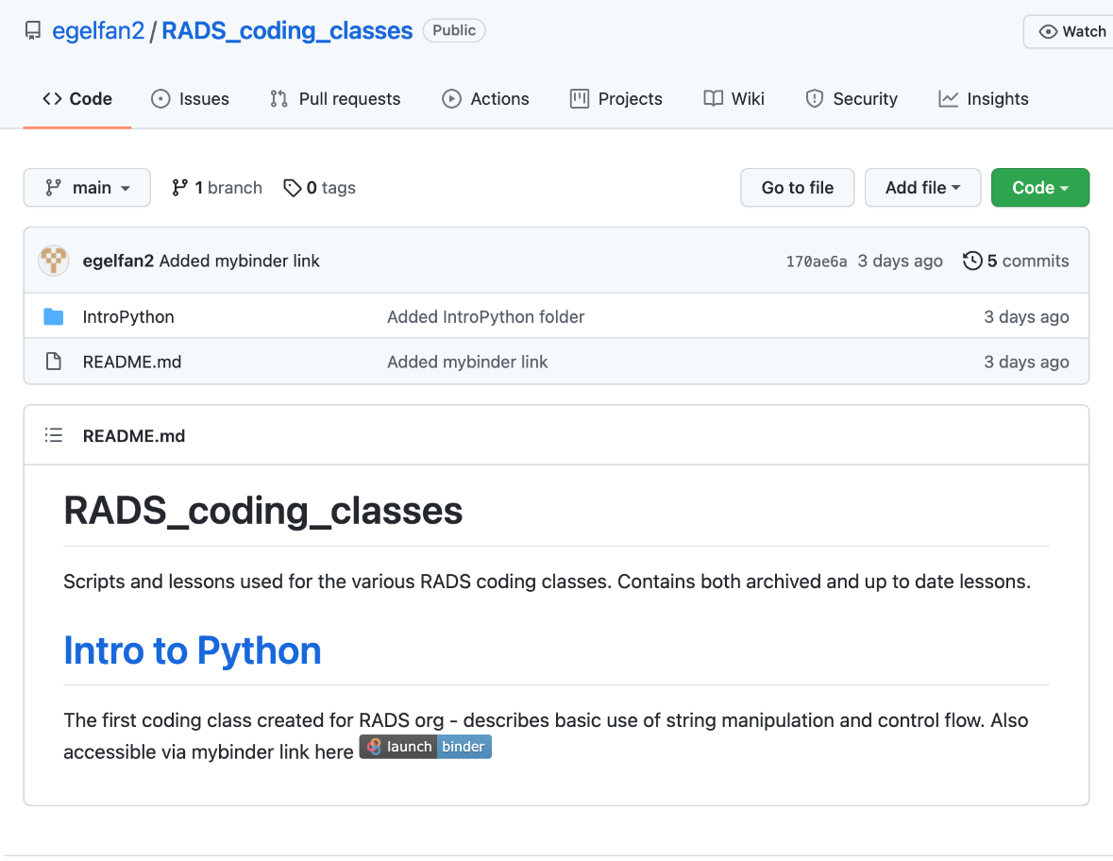
Getting started
We are going to skip installing python for this class and instead practice coding in our browsers.
Go to https://github.com/egelfan2/RADS_coding_classes in your browser or click the link in the email from Monday (or in chat)
Click on launch | binder

Slide 13
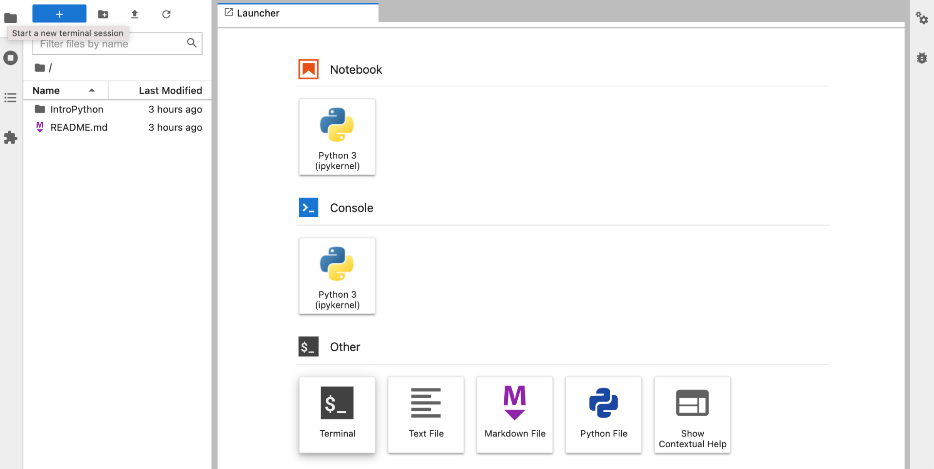
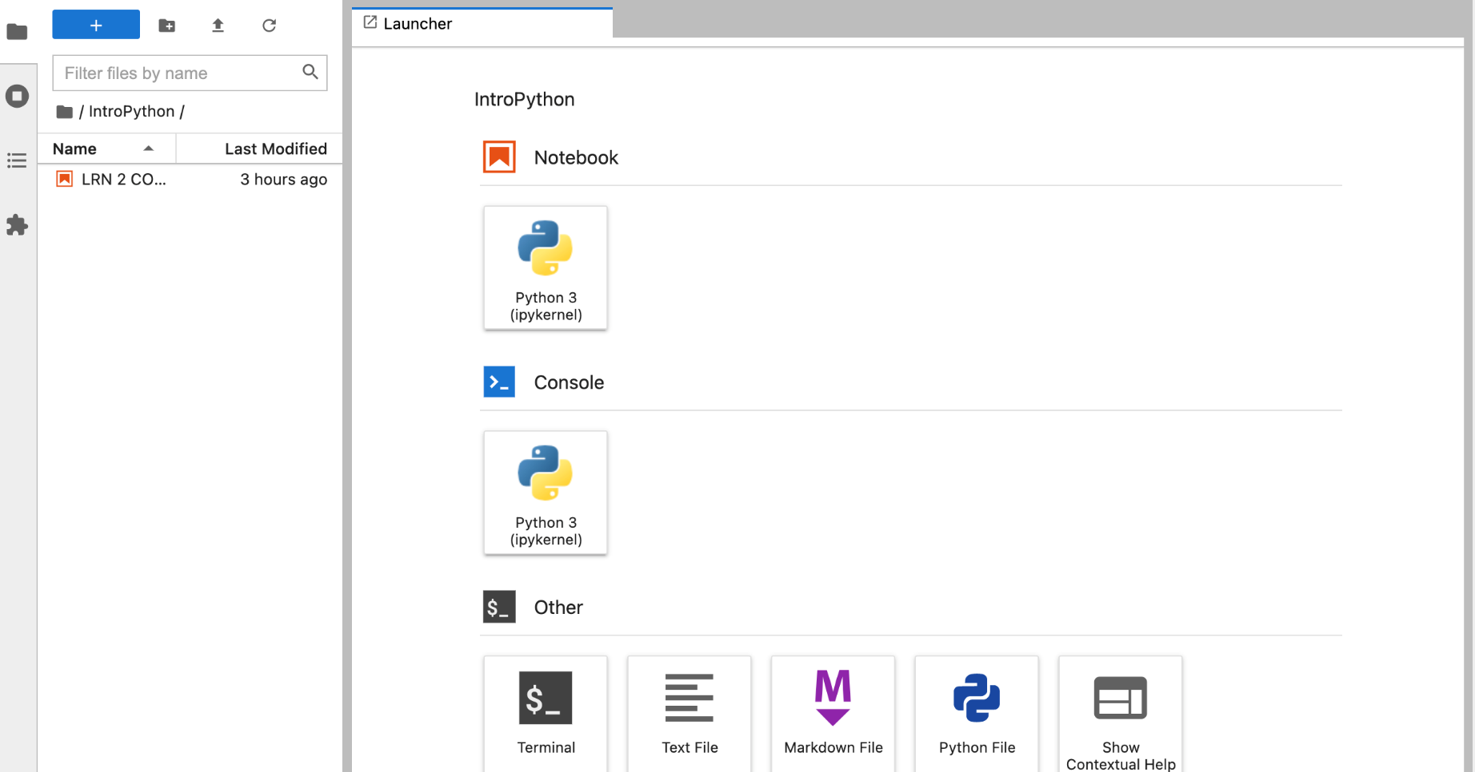
Getting started
Click the IntroPython folder
Click on IntrotoPython to open the jupyter notebook file for today and Friday (we’ll go over this again then!)

Slide 14
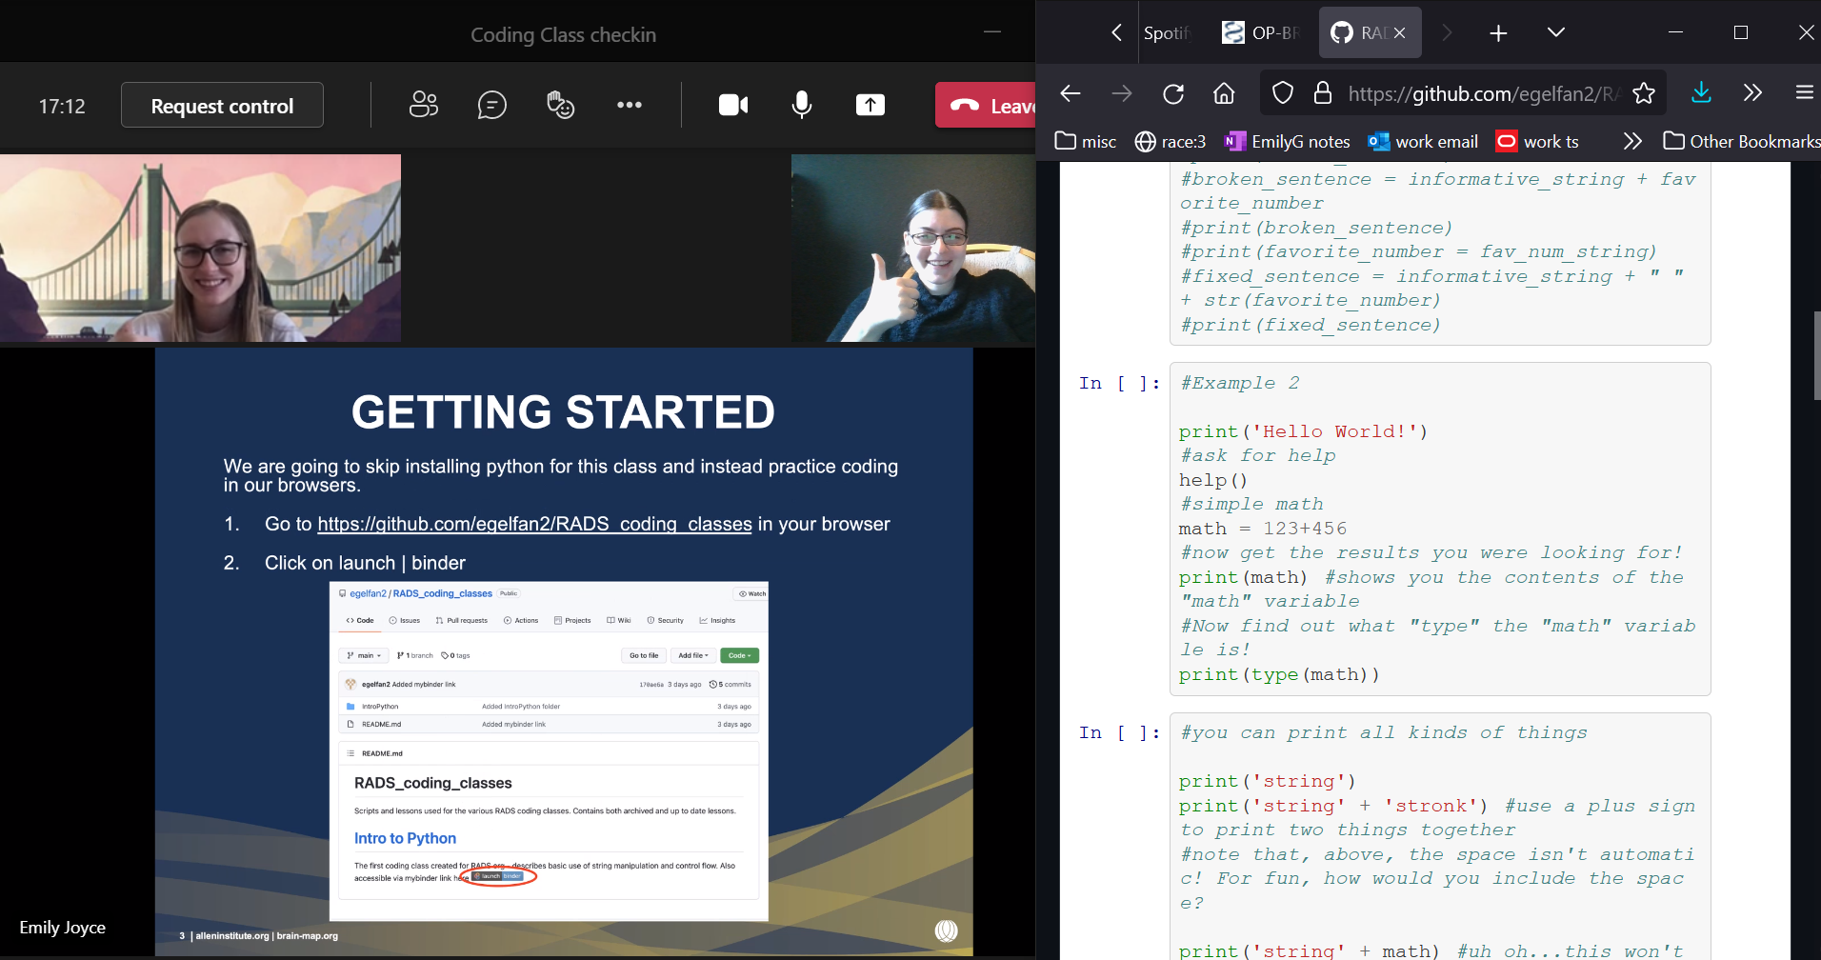
Viewing setup
We suggest that you pull up the jupyter notebook to one side of your screen and watch the lecture slides on another side

Slide 15

Navigating jupyter
Full examples available at:
https://jupyter-notebook.readthedocs.io/en/stable/examples/Notebook/Notebook%20Basics.html

Slide 16
Navigating jupyter: entering code
Each square in which you enter text (see examples below) is called a “cell”
Within cells you can write, edit, and execute code
When the cell has a green border, it’s in “edit mode”, activated by clicking on the cell (first cell below)
When the cell has a grey border with blue left margin, it’s in run or “command mode” (second cell below)
Edit mode:
Command mode:

Slide 17
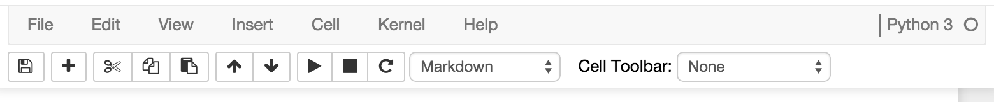
Navigating Jupyter: running what you wrote
Geometric shapes at the top, from left to right:
Save (floppy disk), add (to add another new cell), cut, copy, paste
Up and down arrows move the cell up or down in the notebook to rearrange the order (useful for organizing your code)
Triangle is run, square is stop, circle arrow is restart the kernel (similar to restarting your entire session – all variables will be lost and it’ll be like you just opened the notebook fresh)

Slide 18
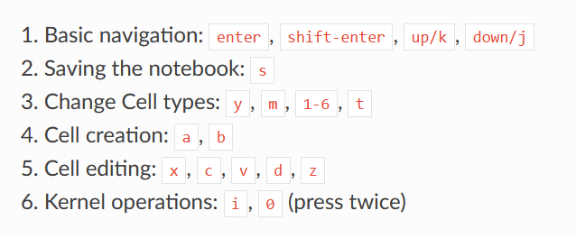
Navigating jupyter: keyboard shortcuts
Press enter to enter edit mode
Press esc to enter command mode
Press shift + enter to run the highlighted cell
Type “help”, then select “keyboard shortcuts” to see more
A few more to get you started:

Slide 19
Getting a taste
OK we get it, programming is amazing, jupyter is the best tool ever… but what do we do to get moving?

Slide 20



Data Types
??
??!!
In English, you (REALLY SHOULD) know about the concept of the differences between “words”, “numbers”, “decimals”, etc. Computers have similar delineations known as “Data Types”
String – Any type of text, in Python delineated by double quotation marks (aka a literal statement). An example of a string is “Sst-IRES-Cre;Ai148”
Integer – just like in math, this is a whole number. An example is 413062
Floating point number – A decimal (can be infinite or NaN). An example is 41.213
Boolean – A value that is True or False and nothing else
List – A collection of values, contained by two brackets. For example, [“animal ID”, “pedigree name”, “project ID”] is a list of mouse information
We use the word for data types rather than the common English words for the concept, as it allows you to be more precise
??

Slide 21
Types cheatsheet
Name | Type | Description
Integer | int | Whole numbers, such as: 3 300 200
Floating point | float | Numbers with a decimal point: 2.3 41.6 507.912
String | str | Ordered sequence of characters: ‘hello world’ ‘Jack123’ “200” “馬 / 马”
List | list | Ordered sequence of separate objects: [15, “dog”, “200”]
Dictionary | dict | Unordered key:value pairs: {“key here” : “value here”, “name” : “Emily”, “workplace”: “Allen Institute”
Set | set | Unordered collection of unique objects: {‘a’, ‘b’, ‘c’}
Boolean | bool | Logical value indicating True or False

Slide 22

Variables
Regardless of which data type you’re using, at some point, you’ll want your code to actually do something (don’t we all). In order to run anything, what you’ll have to do is store information in what’s called a variable, or a way of telling your computer what data to store.
Variables can be named whatever you want, but beware of falling into a few classic traps:
Python (and most other languages) have something called “Keywords”, or words that can’t be used as variable names, function names, or other identifiers, as they’re used to define the structure of the language itself (more on that later)
If you name a variable a single letter when writing code someone else might ever have to look at, you’re going straight to heck.
Notes:
Just like in math! Jupyter notebooks it’ll change color (keywords).

Slide 23
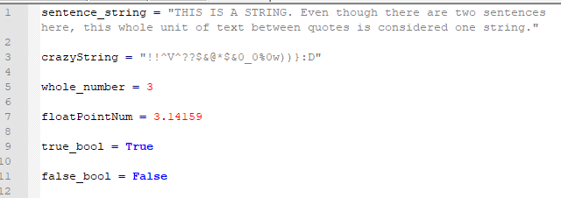
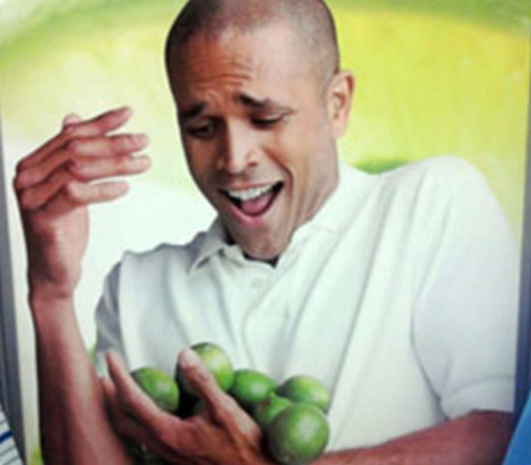
How can I hold all this information?
The previous data types we talked about, stored as variables. Python is a flexible language, which means that it doesn’t make you tell it what data type each variable will be – you just store the variable*
*When writing more complex code in python, such as a larger program or a program that might be used or read by multiple people, it’s considered best practices to declare what “type” you intend a variable to be. This makes the code easier to read and easier to debug. However, when writing one-off scripts, it’s not as critical to do.
Notes:
Equals sign is assignment.

Slide 24
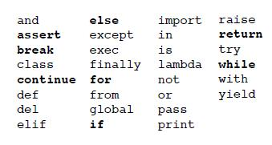
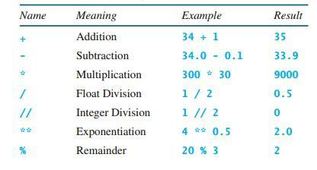
Keywords and Operators
Sometimes, you want to leave a note to yourself (or others) in your code. This is called a comment. Do it more often than you think is necessary! You will definitely *not* remember what you were thinking by tomorrow!
The comment “operator”, or special character that implies mathematical or logical operations, is # - Anything following the # will be ignored by your code (operators work like the “keywords” we mentioned earlier).
For reference, Here’s a short list of keywords (left) and operators (right) so you know what to avoid:

Slide 25
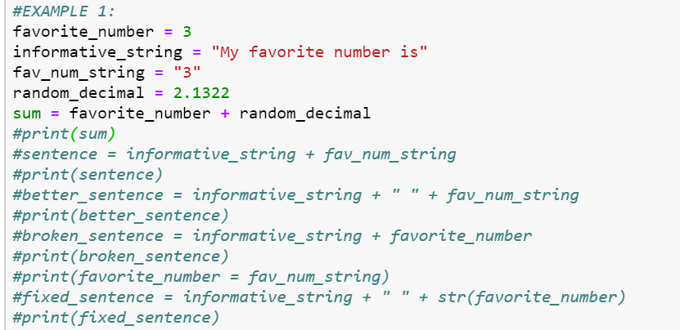
Data Types Matter!
Example 1:

Slide 26
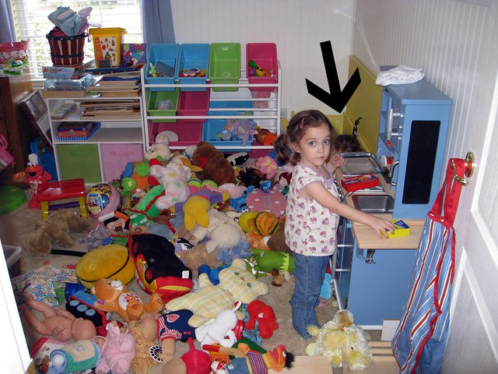
What’s next?
Our second class will be EVEN MORE hands on – see you all 11/19!
Online courses < projects! No problems yet? Make your own!
RADS coding discussion channel to come – use it to ask questions and share solutions!
Not part of the RADS channel on teams? Message !RADS_ORG and we’ll add you, or use join code A9N1LGZ
Me, when practicing coding
Notes:
In our class in two days, we’ll go over the basics again and move on to solving some actual Allen Institute problems we’ve experienced in the past! Powerpoints and code should all be available in the invites sent out to you, but message me if you have any questions/troubles.
Additionally, online courses will help you learn syntax, but what you’ll need in order to actually build a deep understanding of coding is projects! If you’re learning on your own and don’t know any work problems yet, try to come up with some simple problems you face at home or at work and use what we learn together to solve them!

Slide 27
Onwards…to the future!
Best way to learn is by doing!
https://www.khanacademy.org/computing/computer-programming
https://www.w3schools.com/python/
https://www.coursera.org/courses?query=python
And many many many MANY oh god so many more

Slide 28
Thanks for coming!
Questions? Concerns? Suggestions? Need info?
!RADS_ORG

Slide 29
THANK YOU
We wish to thank the Allen Institute for Brain Science founder,
Paul G. Allen, for his vision, encouragement and support.

